Slide 1




EVOLUTION OF CONVECTIVE CELLS IN THE MARINE BOUNDARY LAYER : OBSERVATION VRS CLASS MODEL(MARCH 13TH CASE)
ATMOSPHERIC SYSTEM RESEARCH FUNDED
UNIVERSITY OF WYOMING
DEPARTMENT OF ATMOSPHERIC SCIENCE
RESEARCH PROGRESS
PRESENTED BY:
NATHANIEL ABROKWAH OTENG
MASTER’S STUDENT

Slide 2
OUTLINE
INTRODUCTION
OBJECTIVES
DATA AND METHOD
RESULTS
CONCLUSION

Slide 3
INTRODUCTION
OBJECTIVES
DATA AND METHOD
RESULT
NEXT STEP
Periods of extreme cold impact in the polar and mid-latitudes during winter months.
Depending on the magnitude and duration of the occurrence, extremely cold periods may be deemed cold air outbreaks (CAOs)
Occurs when a mass of cold air moves southward from the Arctic or subarctic regions into lower latitudes, bringing a sudden and significant drop in temperature.
Can lead to extreme weather conditions such as snow, ice storms, and blizzards
Notes:
The marine boundary layer (MBL) is the lowest layer of the atmosphere that is directly influenced by the ocean.
It is typically shallow, but can deepen significantly during cold air outbreaks.
Cold air outbreaks are periods of time when cold air blows over a warmer ocean surface, leading to the formation of shallow convective clouds.
During a cold air outbreak in winter, especially over the ocean, you would typically expect a shallow, stable boundary layer capped by a strong temperature inversion.
Turbulence near the surface, driven by the temperature contrast and wind, and the potential formation of low-level clouds are also key features.
The specific conditions can vary based on the intensity of the cold air outbreak, sea surface conditions, and prevailing winds.

Slide 4
INTRODUCTION
OBJECTIVES
DATA AND METHOD
RESULT
NEXT STEP
WEATHER CONDITION
During COMBLE at the AMF1 site, there were 23 days of CAO conditions, characterized by an average M value of 3.4 K. CAO conditions refer to thermal instability caused by surface heat fluxes.
M>0, where 𝑀 ≡ $θ_{sst}−θ_{850 hpa}$ . SST about 10 km offshore the AMF1 site
Surface Wind Speed > 10 kts and Surface Wind Direction between 250 and 30 degrees
Continuity: Short gaps (1 hr) are skipped; minimum duration of 1hr

Slide 5
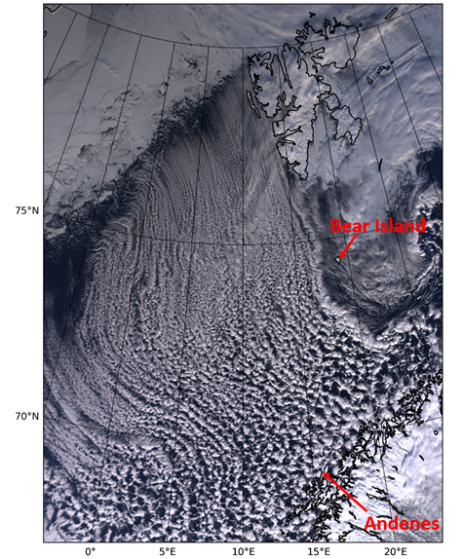
INTRODUCTION
OBJECTIVES
DATA AND METHOD
RESULT
NEXT STEP
To simulate and understand the Lagrangian evolution of open-cellular convection during marine CAO’s using CLASS model
Compare the CLASS simulations against Observation
https://arm.gov/news/features/post/69614
Notes:
The idea is to follow the air parcel from the artic ice edge downwards. That is what we assume in the class model.

Slide 6
INTRODUCTION
OBJECTIVES
DATA AND METHOD
RESULT
NEXT STEP
DATA SOURCE | TIME RESOLUTION
Interpolated Sonde (INTERPOLATEDSONDEARM Mobile Facility (ANX) Andenes, Norway; AMF1 (main site for COMBLE) | 30 seconds
Eddy Correlation Flux Measurement System (30ECOR). ARM Mobile Facility (ANX) Andenes, Norway; AMF1 (main site for COMBLE) | 30 minutes

Slide 7
INTRODUCTION
OBJECTIVES
DATA AND METHOD
RESULT
NEXT STEP
1
Simulate the CLASS model based on marine CAO period.
2
Use the mean sensible heat flux value in ECOR dataset to represent surface kinematic heat flux
3
Use the mean latent heat flux value in ECOR dataset to represent surface kinematic moisture flux.
Notes:
Class is a simple model. It is timely resolved but not horizontally or vertically resolved.
Lagrangian parcel move from the ice over 18 hrs
The idea is to follow the air parcel from the artic ice edge downwards. That is what we assume in the class model.
Look at what is happening at the observational site too.

Slide 8
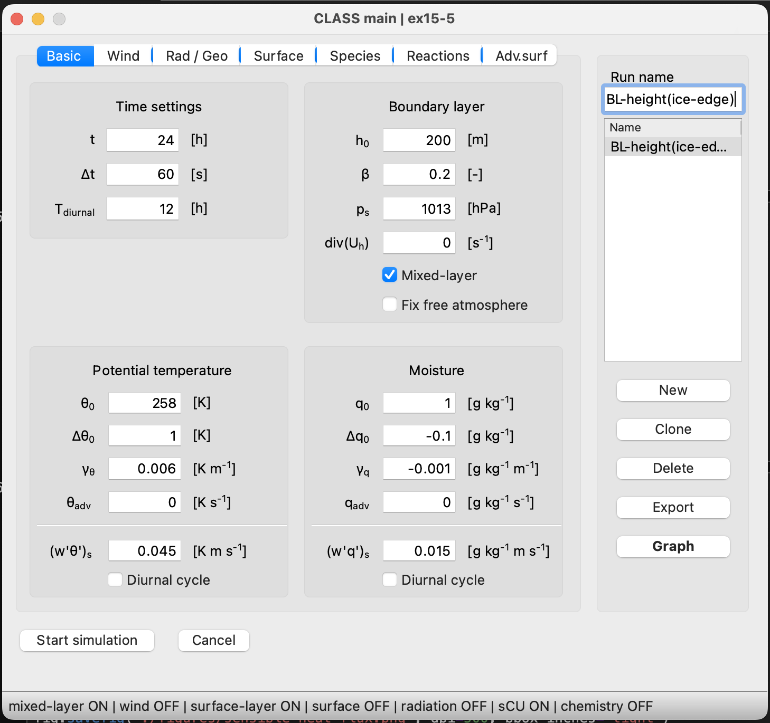
INTRODUCTION
OBJECTIVES
DATA AND METHOD
RESULT
NEXT STEP
Notes:
Lagrangian parcel move from the ice over 18 hrs.
Temperature at the artic edge is -15C which correspond to lower q0.
Ro = 0 because there wasn’t much stable layer.
Delta-q = -0.1 since there is not that much water vapor in the artic.
q_Adv = we assume this is Lagrangian so we assume no advection.

Slide 9
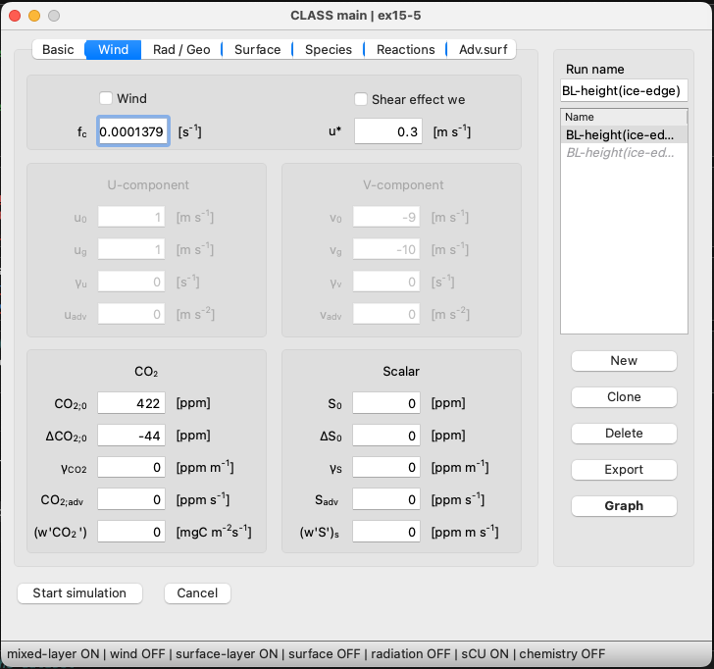


INTRODUCTION
OBJECTIVES
DATA AND METHOD
RESULT
NEXT STEP

Slide 10
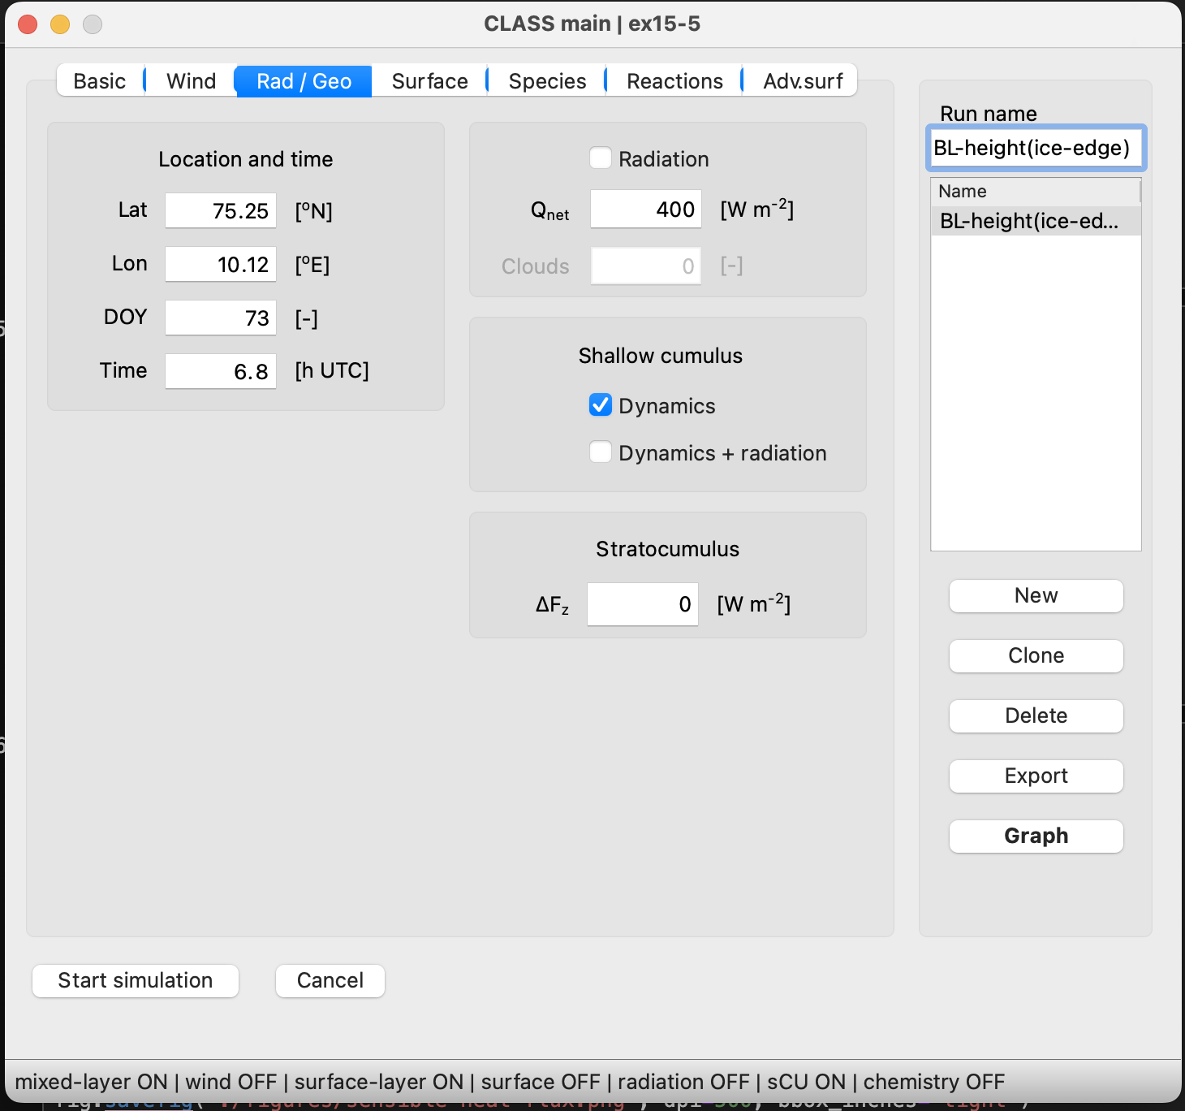
INTRODUCTION
OBJECTIVES
DATA AND METHOD
RESULT
NEXT STEP
Notes:
Because it is over water, radiation is turned off

Slide 11
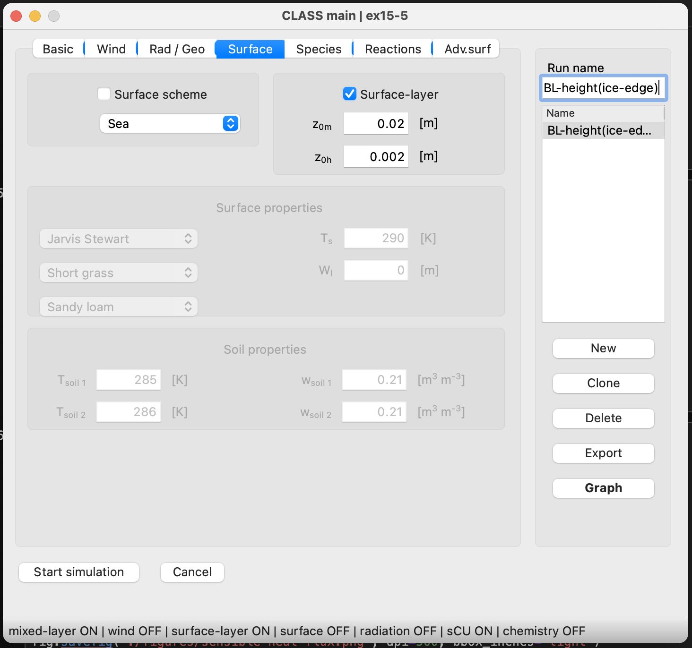
INTRODUCTION
OBJECTIVES
DATA AND METHOD
RESULT
NEXT STEP

Slide 12
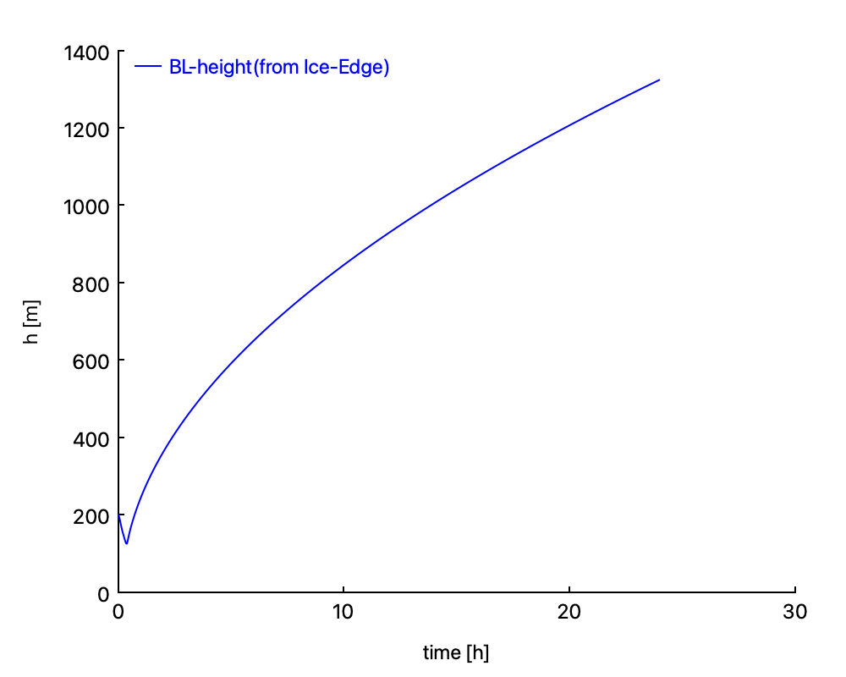
INTRODUCTION
OBJECTIVES
DATA AND METHOD
RESULT
NEXT STEP
Initial drip
Steady increase
No diurnal pattern
Continue growth suggest a sustained cold air outbreak event.
Fig. 1. Temporal Evolution of Marine Boundary Layer Height During a Cold Air Outbreak from an Ice Edge
Notes:
Initial Dip: There is an initial sharp decrease in the boundary layer height at the very beginning. This could indicate rapid cooling or stabilization of the boundary layer when the air first comes into contact with the ice edge.
Steady Increase: After the initial drop, the boundary layer height increases steadily over time. This could be a result of the cold air mass picking up heat and moisture from the open water, which destabilizes the boundary layer and promotes its growth.
No Diurnal Pattern: The graph does not show any obvious diurnal pattern, which would typically be characterized by rises and falls corresponding to day-night cycles. This could suggest that the impact of the cold air outbreak and the ice-water interface is the dominant process controlling the boundary layer height, rather than solar heating.
Continuous Growth: The continuous growth over a 30-hour period suggests a sustained cold air outbreak event. The heat flux from the ocean is likely strong enough to continue destabilizing the boundary layer, allowing it to grow in height.
Boundary Layer Dynamics: The nature of the boundary layer growth suggests that the dynamics of the cold air outbreak are complex. The steady increase in height could indicate a gradual adjustment of the marine boundary layer to the underlying sea surface conditions and the ongoing heat and moisture fluxes.

Slide 13
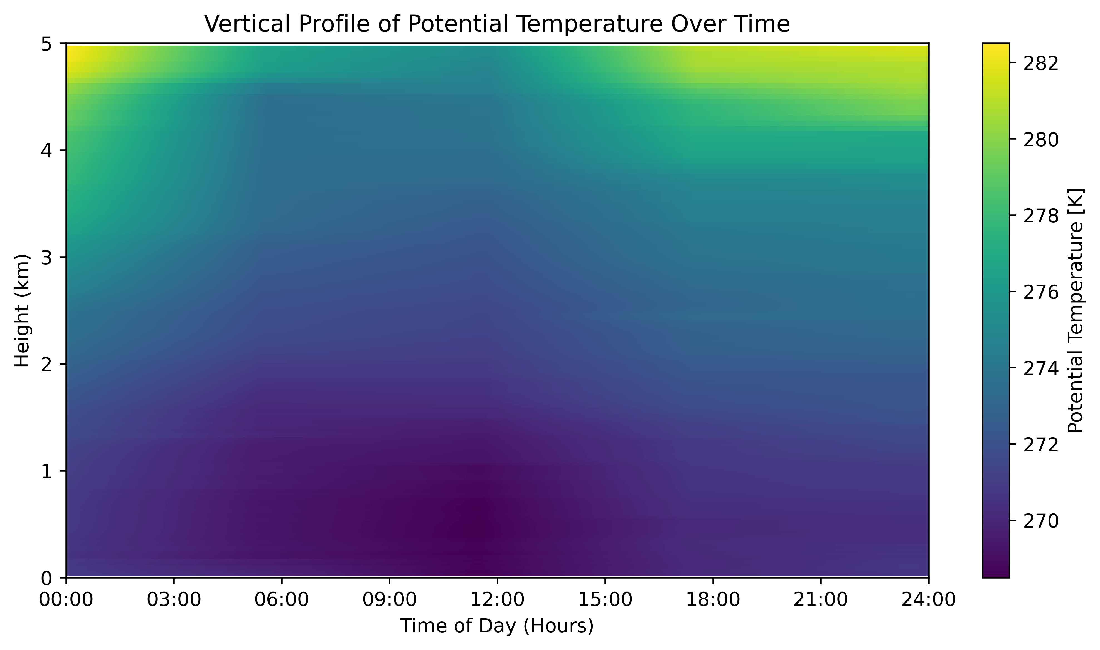
INTRODUCTION
OBJECTIVES
DATA AND METHOD
RESULT
NEXT STEP
Stable stratification in the boundary layer.
Potential temperature remains within the narrow range.
No significant diurnal variation.
High temperatures aloft.
Fig. 2.1 Stable Potential Temperature Profile during CAO at Andenes.
Notes:
Stable Profile: The potential temperature appears to be fairly uniform with height throughout the day, indicating a stable stratification in the boundary layer. This is typical during cold air outbreaks, where strong temperature inversions can suppress vertical mixing.
Potential Temperature Range: The potential temperature remains within a narrow range, suggesting that the vertical temperature gradient is quite stable.
No Significant Diurnal Variation: There is no clear indication of diurnal warming or cooling, which would be shown by a significant shift in colors (potential temperature) with time. This reinforces the influence of the cold air outbreak on maintaining a stable boundary layer.
Higher Temperatures Aloft: The lighter colors (warmer potential temperatures) at the upper levels of the graph may indicate a capping inversion, which is a warmer layer of air above the cooler air closer to the surface. This inversion can act as a lid, limiting vertical motion.
Implications for Weather Conditions: Such a stable profile may lead to calm but cold weather conditions at the surface, with limited cloud development unless there is sufficient moisture and a disturbance to lift the air.

Slide 14
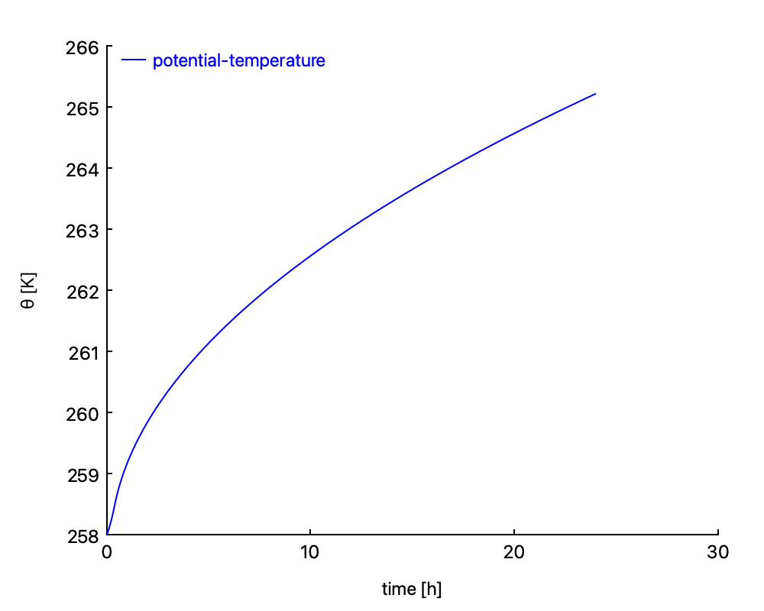
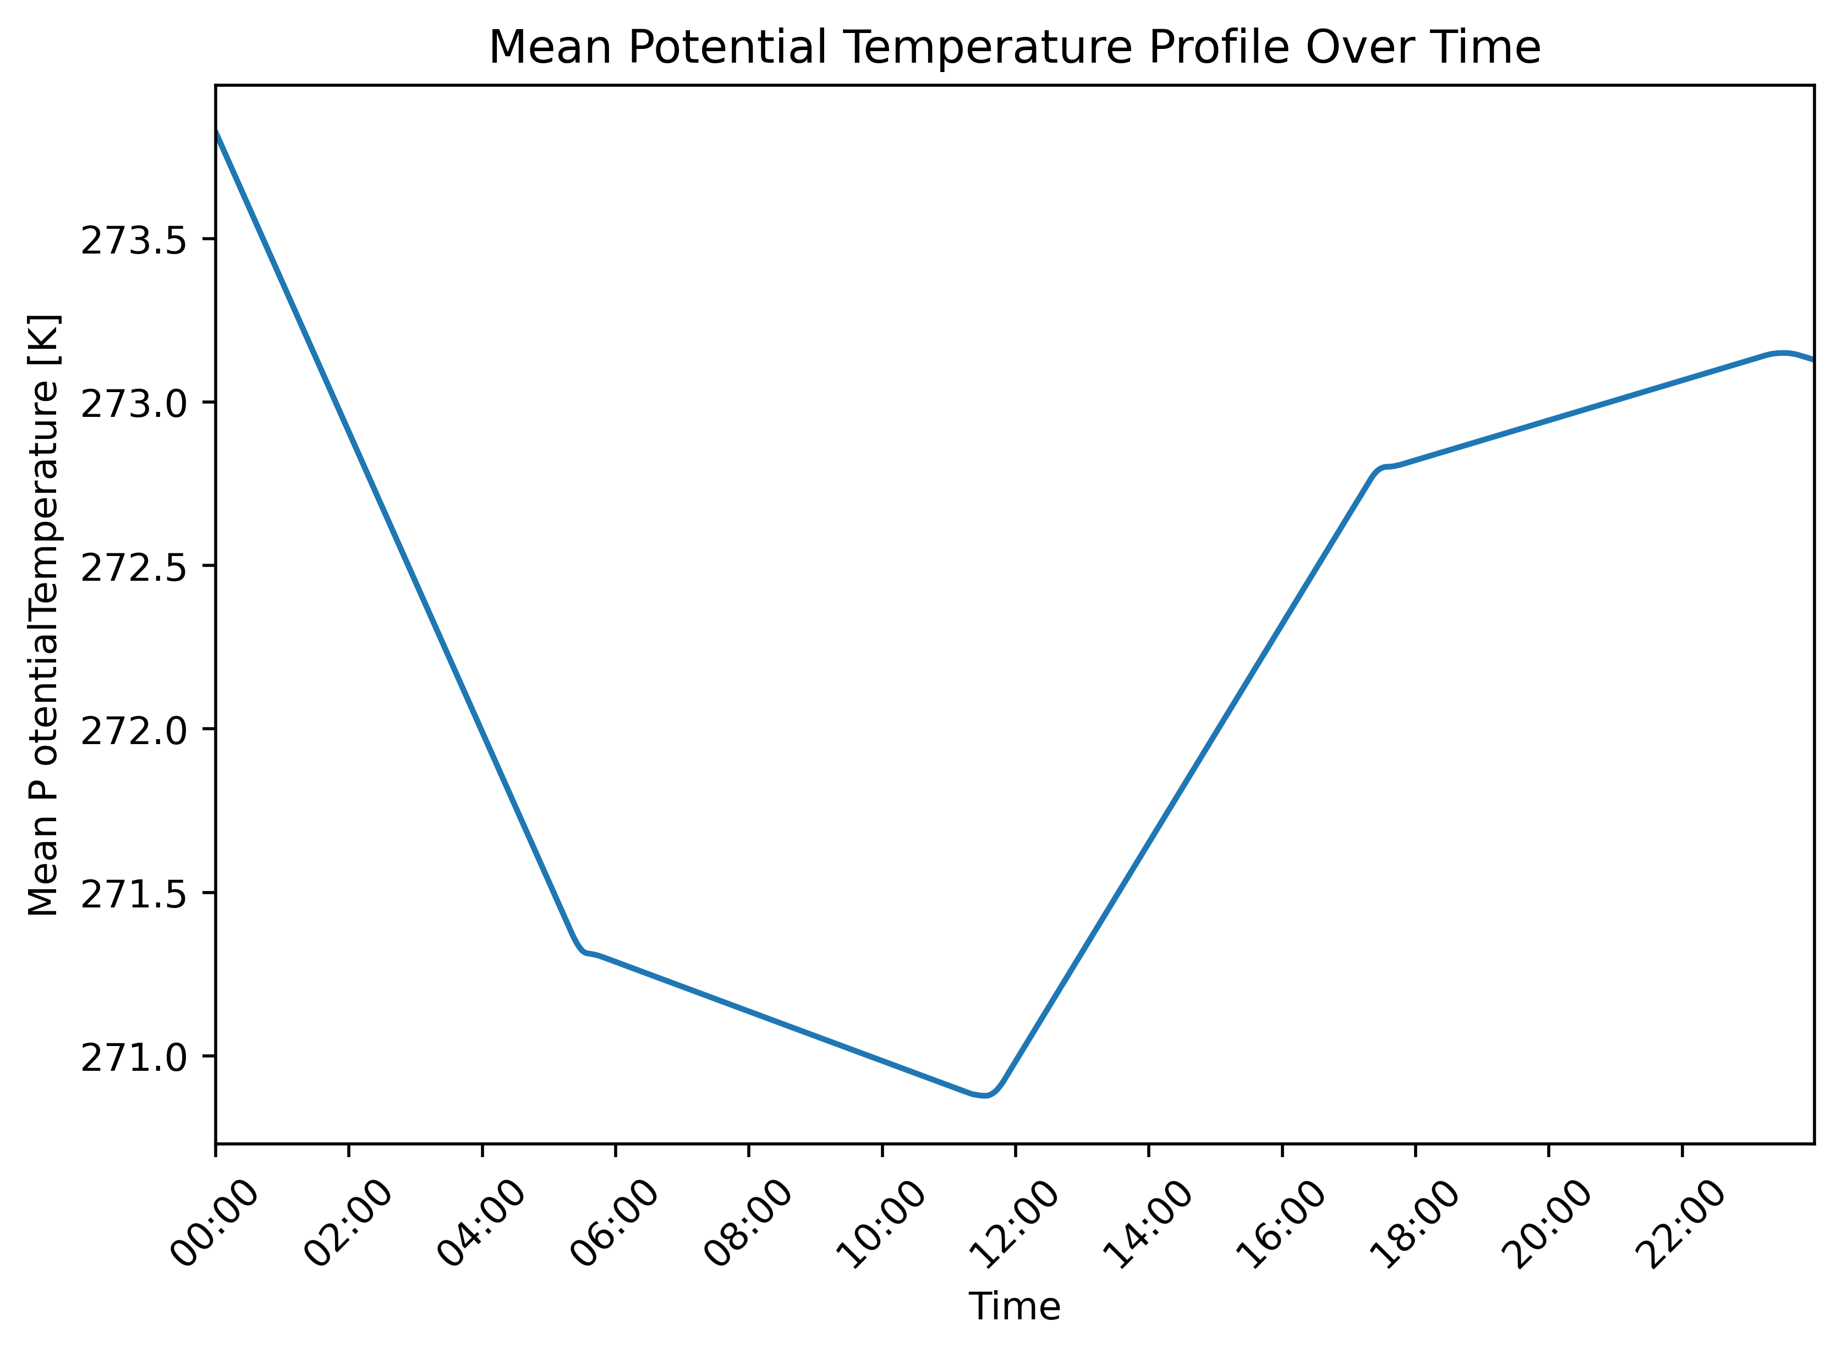
INTRODUCTION
OBJECTIVES
DATA AND METHOD
RESULT
NEXT STEP
Fig.2.2. Potential Temperature from Ice Edge
Fig. 2.3 Mean Potential Temperature at Andenes
Fig.2.2 demonstrates a gradual increase in potential temperature from the ice edge over 30 hours, suggesting a warming trend or changing air mass. Fig.2.3 depicts the diurnal variation of mean potential temperature at Andenes, with an initial drop, likely due to nighttime cooling, followed by a rise and stabilization, indicative of the cold air outbreak's impact on maintaining a relatively stable temperature despite daily solar heating cycles.
Notes:
Left Graph - Potential Temperature from Ice Edge:
This graph shows a continuous increase in potential temperature over a 30-hour period, starting from a sharp dip at the beginning. This could indicate the advection of warmer air or an increase in heat flux from the ice edge over time.
Right Graph - Mean Potential Temperature at Andenes:
The right graph displays mean potential temperature over a 24-hour period at the Andenes observational site. The profile exhibits a significant drop in the early hours, which could be due to radiational cooling during the night. Subsequently, there is a noticeable increase and then a slight decline followed by a plateau towards the evening, which might be associated with the diurnal cycle of solar heating and stabilization of the boundary layer in the evening.

Slide 15
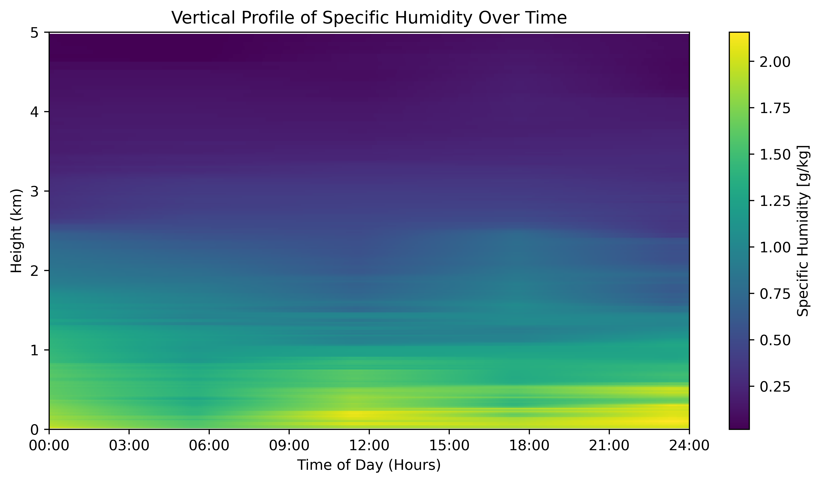
INTRODUCTION
OBJECTIVES
DATA AND METHOD
RESULT
NEXT STEP
Higher Humidity at Lower Altitudes
Stable Over Time
Decrease with Altitude:
No Diurnal Variation
Fig. 3.1 Stable Specific Humidity Distribution Profile during CAO at Andenes.
Notes:
Analysis:
Higher Humidity at Lower Altitudes: The specific humidity is higher closer to the surface, as indicated by the yellow and green colors at lower altitudes. This is consistent with the typical vertical distribution of moisture in the atmosphere.
Stable Over Time: There appears to be little variation in specific humidity with time, suggesting stable atmospheric conditions over the period represented. This could be due to the cold air outbreak creating a stable layer that inhibits vertical mixing and keeps the humidity profile relatively constant.
Decrease with Altitude: There's a clear decrease in specific humidity with altitude, as indicated by the transition from warmer to cooler colors. This is a common feature in the atmosphere due to the decrease in temperature and moisture-carrying capacity with height.
Uniformity Across Heights: The color bands are horizontal and uniform, implying that the specific humidity at any given height does not change much over the 24-hour period.
No Diurnal Variation: Unlike temperature, there is no clear sign of diurnal variation in specific humidity. This could be indicative of the strong influence of the cold air outbreak, which might be overriding the usual diurnal patterns.

Slide 16
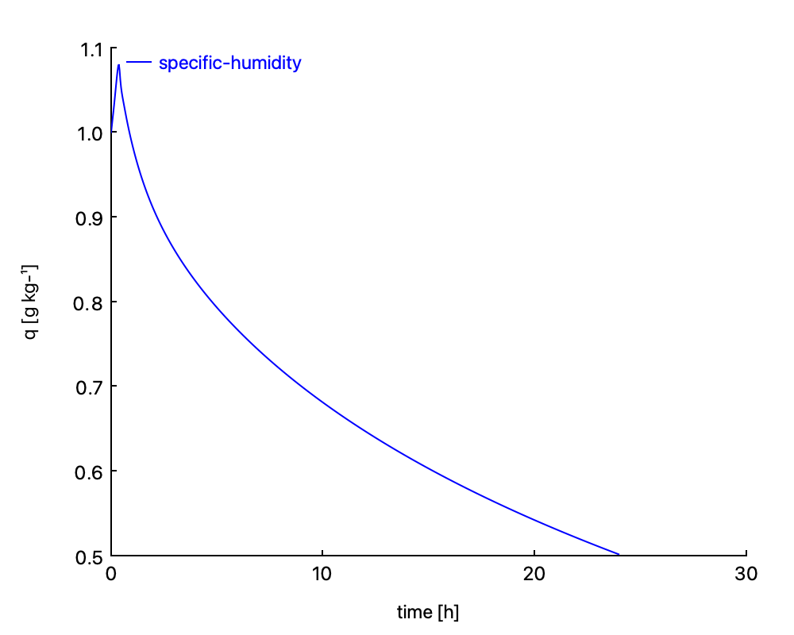
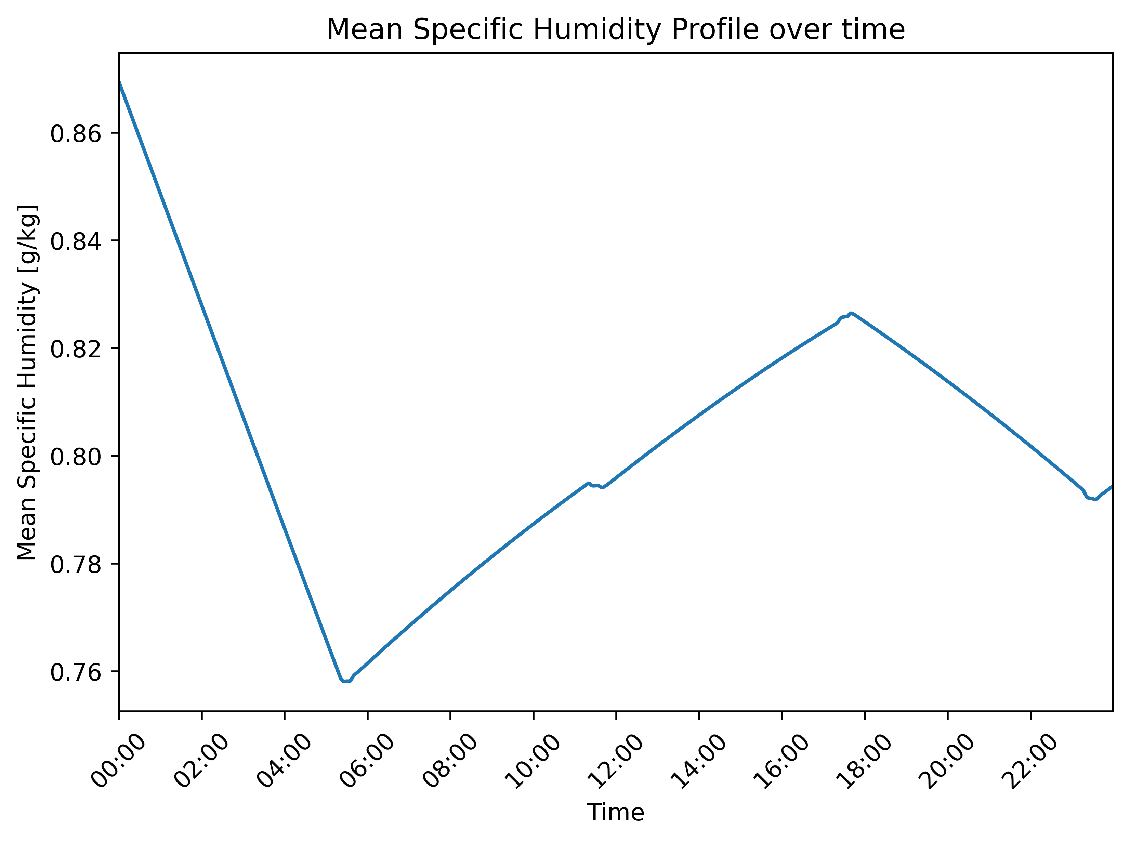
INTRODUCTION
OBJECTIVES
DATA AND METHOD
RESULT
NEXT STEP
Fig. 3.2 Decreasing Specific Humidity Gradient from Ice Edge over Time
Fig3.3 Diurnal Variation of Mean Specific Humidity at Andenes
Figure 3.2 depicts a steady decrease in specific humidity over 30 hours, likely due to the air mass moving away from the moisture-rich ice edge into colder and drier regions or experiencing adiabatic warming. In contrast, Figure 3.3 displays diurnal variability in specific humidity at Andenes, with a significant drop in the early morning hours followed by an increase during the day and a decline in the evening, consistent with the typical diurnal temperature cycle's effect on the air's capacity to hold moisture. Collectively, these figures highlight the interplay between large-scale air mass movements and local diurnal cycles in determining specific humidity dynamics.
Notes:
Left Graph - Specific Humidity from Ice Edge:
The left graph shows a marked decrease in specific humidity over a 30-hour period. This trend suggests a drying of the air as it moves away from the ice edge, which could be due to adiabatic warming of descending air or less moisture availability.
Right Graph - Mean Specific Humidity at Andenes:
The right graph depicts the mean specific humidity over a single day at Andenes. After an initial sharp decline, there is a rise during the day, possibly due to increased evaporation or local moisture sources, followed by another decline towards the evening, which could be attributed to falling temperatures and condensation.
Combined Analysis:
The left graph indicates a long-term decrease in humidity from the ice edge, consistent with the air mass moving over colder, less moist surfaces or changes in air mass characteristics. The right graph shows more variation, likely influenced by local diurnal processes.

Slide 17
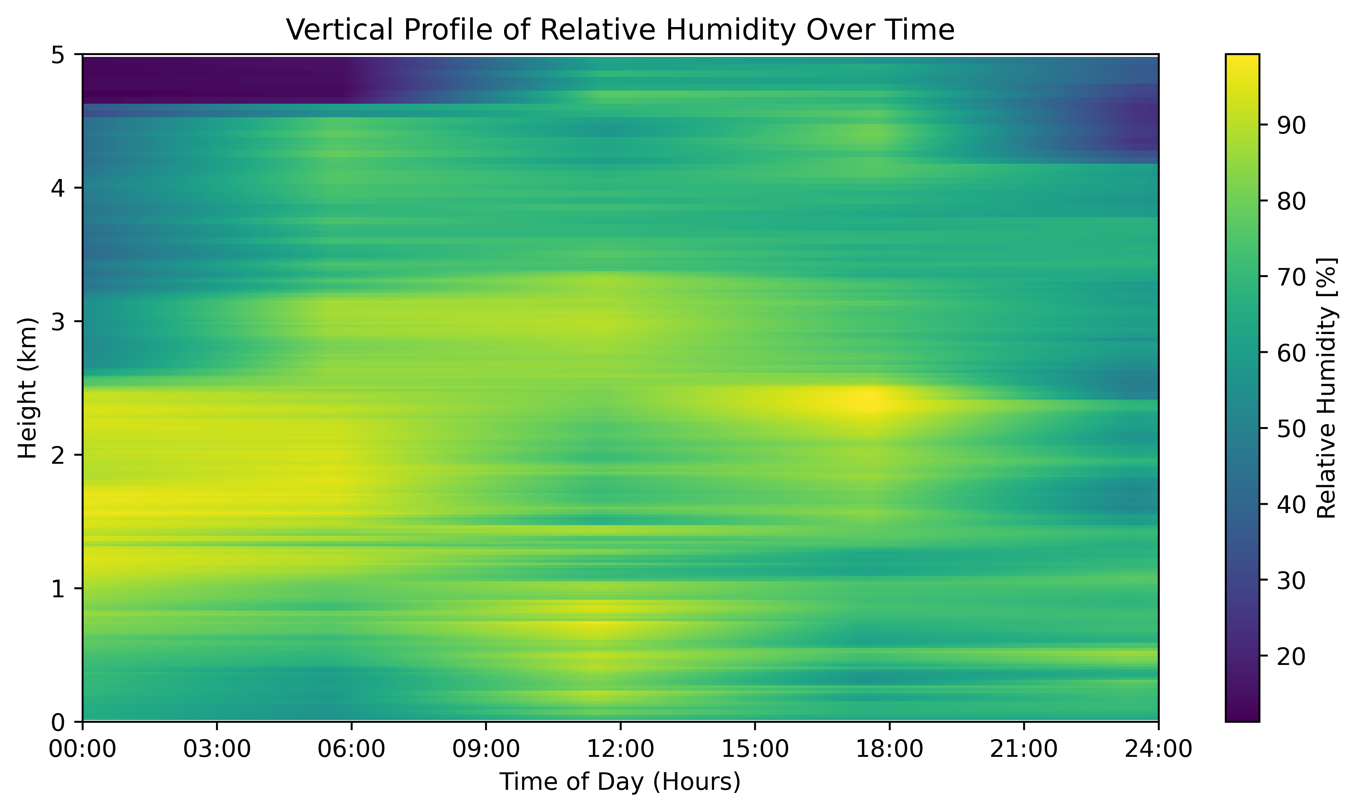
INTRODUCTION
OBJECTIVES
DATA AND METHOD
RESULT
NEXT STEP
Varied distribution of relative humidity with height
Diurnal Variation
Midday Moisture
Fig. 4.1 Diurnal Variation in Vertical Relative Humidity During CAO at Andenes
Notes:
Relative Humidity Gradient: There is a varied distribution of relative humidity with height. Lower levels show regions of both higher and lower humidity throughout the day, while higher altitudes generally display more uniformity.
Diurnal Variation: There appears to be a diurnal cycle, particularly noticeable at lower altitudes, with relative humidity levels changing throughout the day.
Midday Moisture: A band of higher relative humidity is visible at lower altitudes around midday, which may suggest increased moisture possibly due to local evaporation effects, rising air, or other processes that increase humidity.
Overall Stability: Despite the diurnal changes, the overall pattern of relative humidity does not show dramatic shifts, which could imply a relatively stable air mass in terms of moisture content over the observational period.

Slide 18
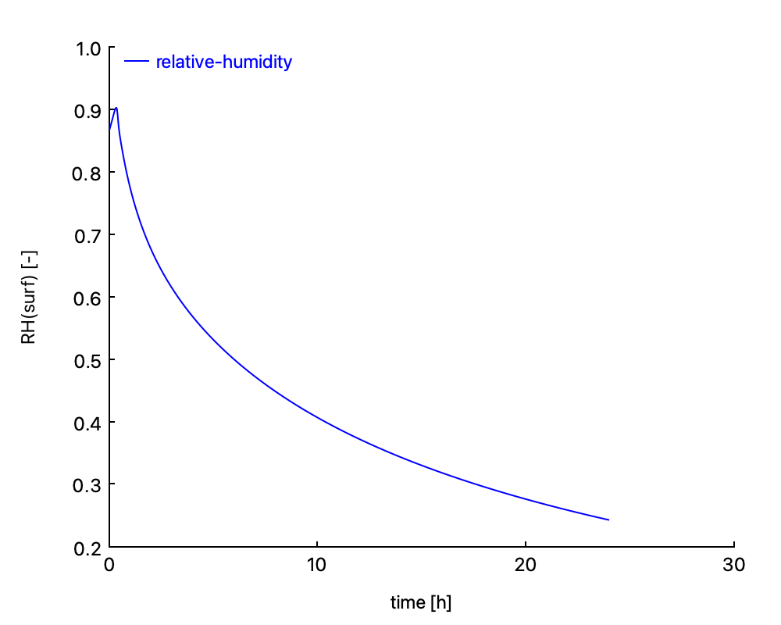
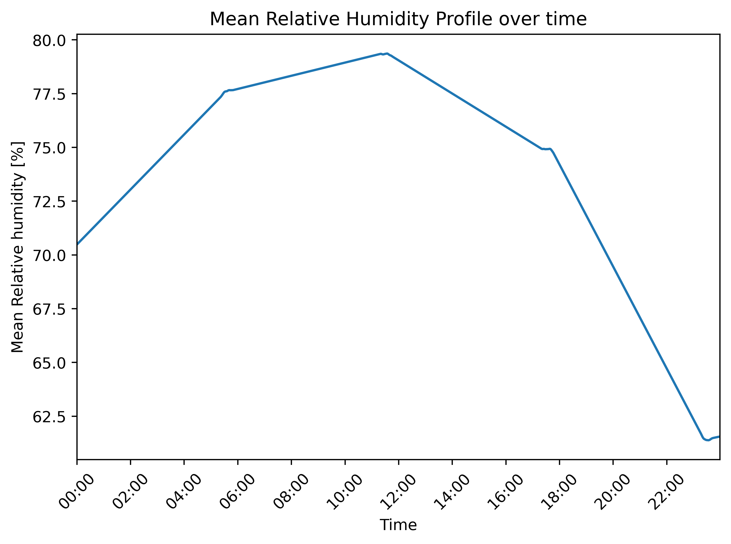
INTRODUCTION
OBJECTIVES
DATA AND METHOD
RESULT
NEXT STEP
Fig. 4.2.Decreasing Relative Humidity Trend from the Ice Edge
Fig. 4.3 Diurnal Cycle of Mean Relative Humidity at Andenes
Notes:
The left plot indicates a continuous decrease in relative humidity over a 30-hour period from the ice edge. This trend suggests that the air mass is becoming progressively drier as it moves away from the ice edge, likely due to encountering colder and drier conditions or through adiabatic warming and drying as the air descends.
The right plot shows the mean relative humidity over time at the Andenes site. It exhibits a rise in relative humidity during the early hours, reaches a peak, and then sharply drops towards the evening. This pattern is indicative of a diurnal cycle, with humidity building up during the cooler morning hours, peaking, and then dropping in the evening as the temperature decreases.
Together, the plots illustrate that relative humidity is influenced by both large-scale movements of air masses, which show a decreasing trend away from the ice edge, and local diurnal cycles, which create fluctuations in humidity levels at a specific location like Andenes.

Slide 19
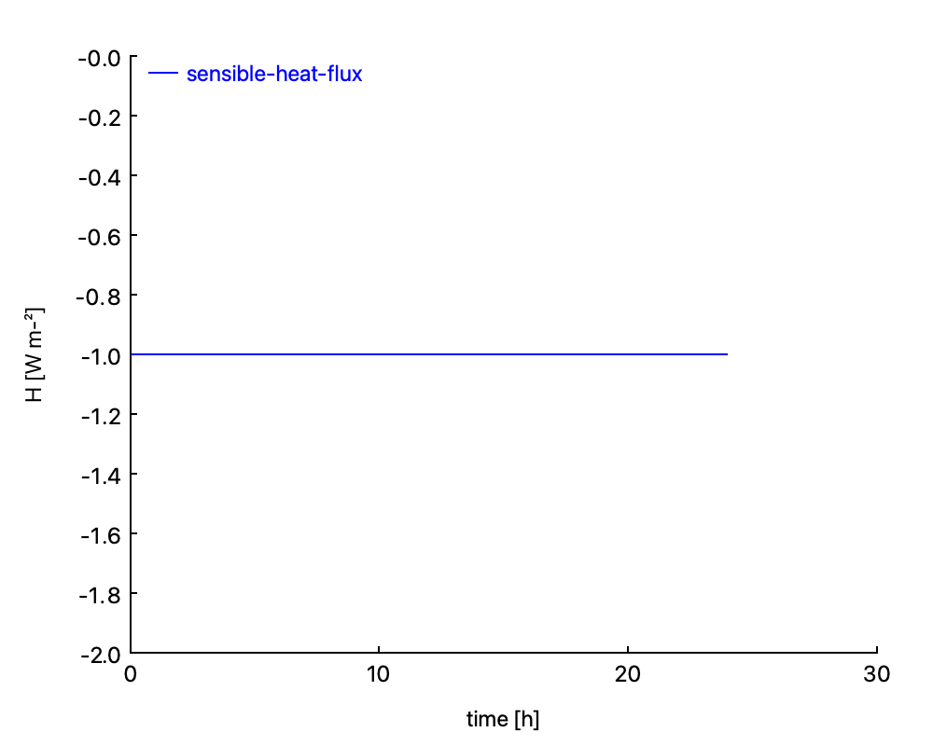
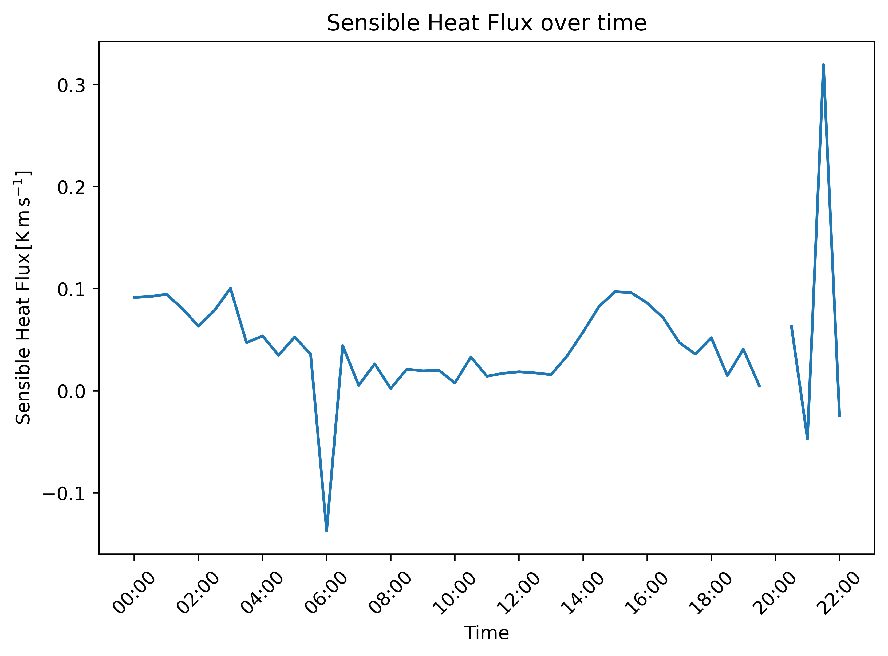
INTRODUCTION
OBJECTIVES
DATA AND METHOD
RESULT
NEXT STEP
Fig. 5.1 Consistent Negative Sensible Heat Flux at Ice Edge
Fig. 5. 2 Diurnal and Event-Driven Variability in Sensible Heat Flux at Andenes
These plots suggest different local conditions and processes at play. The consistent pattern from the ice edge aligns with the expectation of a stable and cold surface continuously cooling the overlying air. In contrast, the Andenes site shows diurnal variability affected by local weather conditions, surface heating and cooling, and possibly other atmospheric phenomena.
Notes:
Left Plot - Sensible Heat Flux from Ice Edge:
The plot shows a relatively constant, slightly negative sensible heat flux over a 30-hour period. This suggests a consistent loss of heat from the surface to the atmosphere, which is typical in cold environments where the air above the surface is warmer than the ice.
Right Plot - Sensible Heat Flux at Andenes:
This plot exhibits significant variability in sensible heat flux over a 24-hour period, with values fluctuating above and below zero. The positive values indicate periods when the surface is warming the air above (usually during the day), and negative values represent cooling of the surface (typically during the night). The sharp spikes, particularly the one late in the day, could indicate specific events that caused rapid changes in heat flux, such as a change in cloud cover or a sudden shift in wind bringing different air masses.
Combined Analysis:
Together, these plots suggest different local conditions and processes at play. The consistent pattern from the ice edge aligns with the expectation of a stable and cold surface continuously cooling the overlying air. In contrast, the Andenes site shows diurnal variability affected by local weather conditions, surface heating and cooling, and possibly other atmospheric phenomena.

Slide 20

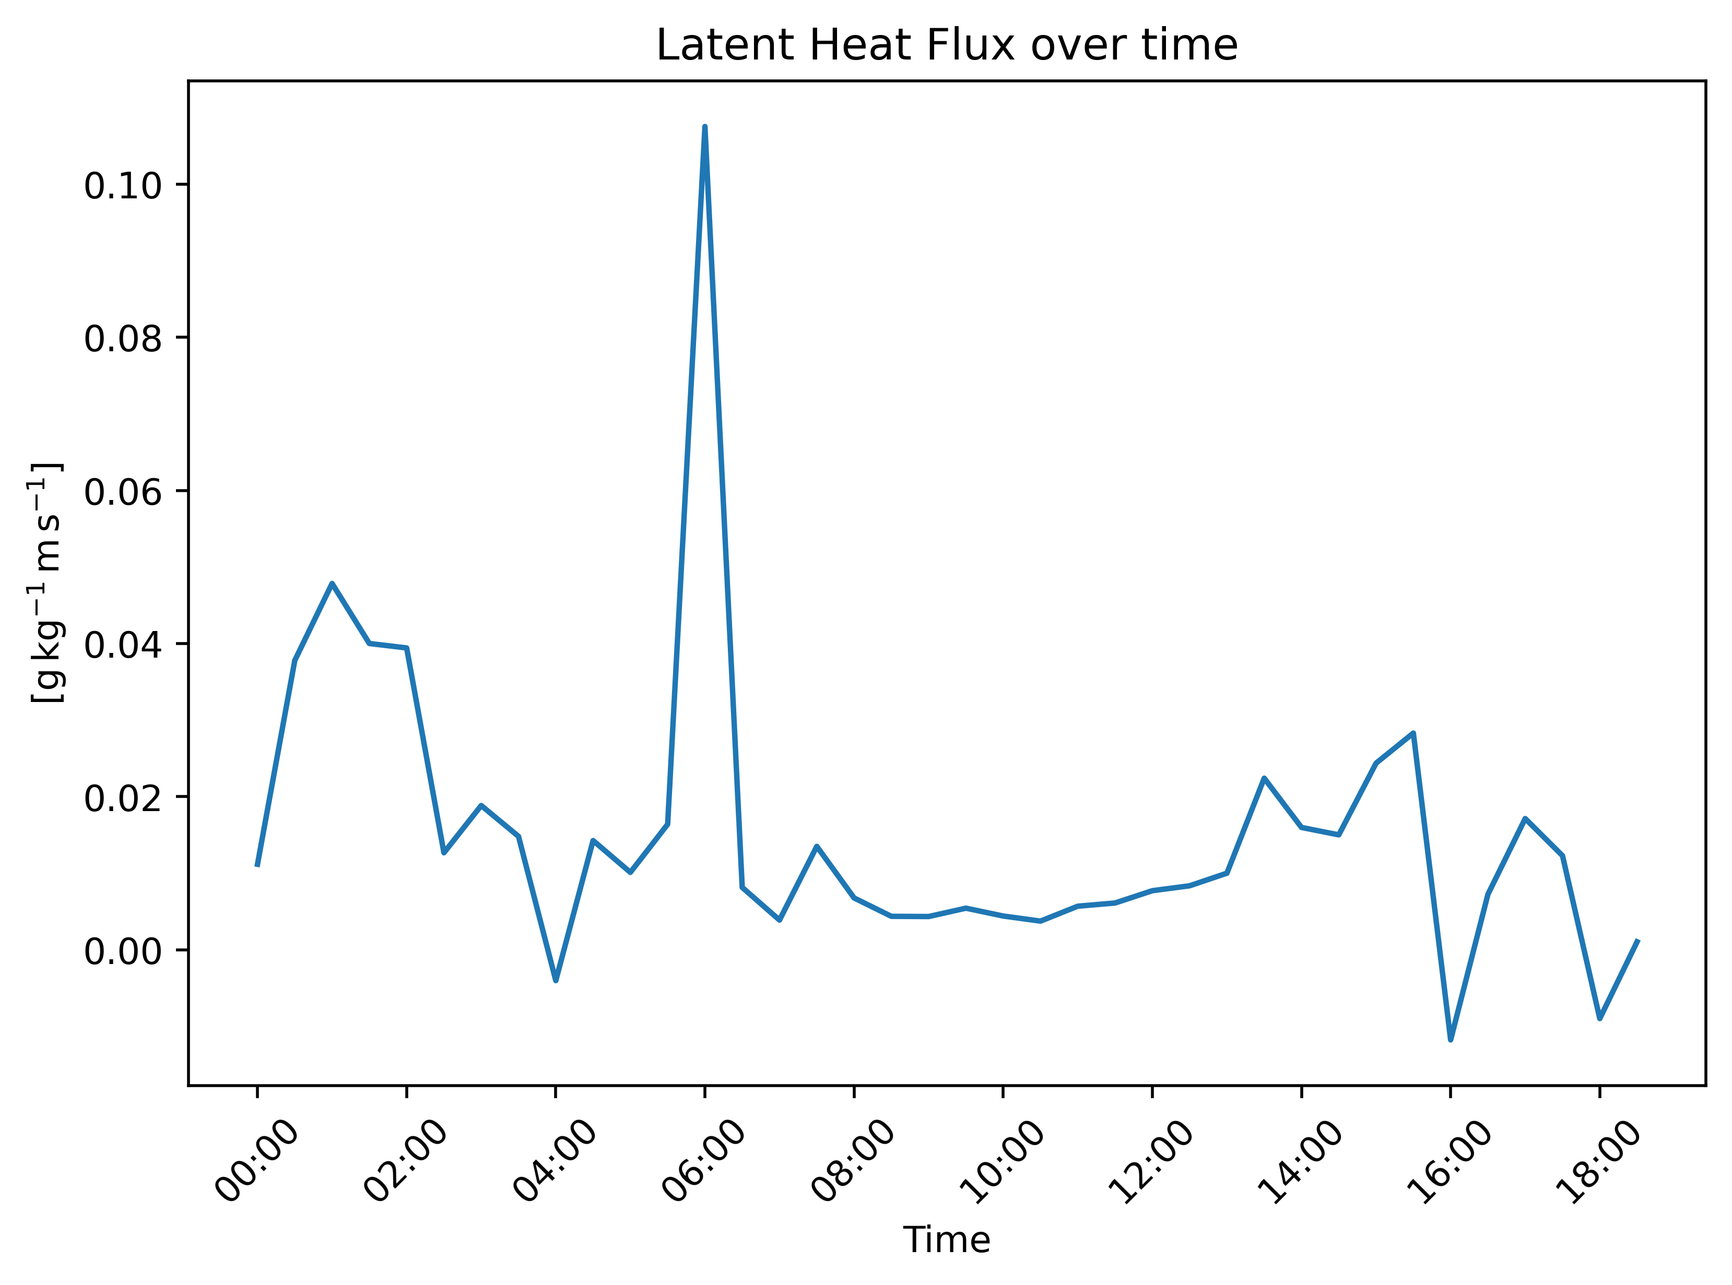
INTRODUCTION
OBJECTIVES
DATA AND METHOD
RESULT
NEXT STEP
Fig. 6.2 Variable Latent Heat Flux Dynamics at Andenes Site
Fig 6.1 Stable Negative Latent Heat Flux at Ice Edge
Notes:
Left Plot - Latent Heat Flux from Ice Edge:
The left plot shows a nearly constant latent heat flux, with slightly negative values over a 30-hour period. This indicates a consistent release of heat from the surface to the atmosphere, likely due to sublimation or evaporation at the ice edge, which is a less intense process than sensible heat flux.
Right Plot - Latent Heat Flux at Andenes:
The right plot presents more variability in latent heat flux throughout the day. Peaks suggest moments of increased evaporation or sublimation, possibly due to higher temperatures or wind events that enhance the transfer of moisture from the surface to the atmosphere. The negative dips could represent condensation events, where latent heat is released as moisture in the air transitions to dew or frost.
Combined Analysis:
The constant, negative latent heat flux at the ice edge is indicative of a stable environment where the ice surface consistently loses moisture. At Andenes, the fluctuating latent heat flux values suggest a more dynamic environment with episodic moisture transfer events influenced by local conditions such as temperature changes, wind patterns, and possibly the presence of open water or moisture sources.
Conclusion:
The latent heat flux data shows how different surface conditions at the ice edge and Andenes impact the moisture transfer processes in these polar regions. The consistent pattern from the ice edge contrasts with the dynamic, diurnal, and event-driven variations at Andenes, highlighting the complex interactions between the surface and the atmosphere in these distinct locations.

Slide 21
INTRODUCTION
OBJECTIVES
DATA AND METHOD
RESULT
CONCLUSION
Ice Edge(CLASS Model):
The air grows colder and drier over time.
Heat is consistently lost from the ice into the atmosphere.
Moisture loss is steady, suggesting freezing or drying conditions.
Andenes Site (Observation):
Temperature varies, showing typical daily warming and cooling.
Humidity swings throughout the day, with more moisture in the air during the day than at night.
Heat exchange between the ground and air changes a lot, with the ground sometimes warming the air and sometimes cooling off.
Moisture transfer is irregular, with bursts of activity likely due to changing weather like wind or rain.
4

Slide 22
References
Atmospheric Radiation Measurement (ARM) user facility. 2019. Eddy Correlation Flux Measurement System (30ECOR). 2020-03-13 to 2020-03-13, ARM Mobile Facility (ANX) Andenes, Norway; AMF1 (main site for COMBLE) (M1). Compiled by R. Sullivan, D. Billesbach, E. Keeler, B. Ermold and S. Pal. ARM Data Center. Data set accessed 2023-11-29 at http://dx.doi.org/10.5439/1025039.
Atmospheric Radiation Measurement (ARM) user facility. 2019. Interpolated Sonde (INTERPOLATEDSONDE). 2020-03-13 to 2020-03-13, ARM Mobile Facility (ANX) Andenes, Norway; AMF1 (main site for COMBLE) (M1). Compiled by M. Jensen, S. Giangrande, T. Fairless and A. Zhou. ARM Data Center. Data set accessed 2023-11-29 at http://dx.doi.org/10.5439/1095316.

Slide 23


